Slide 1

STOCK PREDICTION
Akshit NANDA – 2210990093
GURNOOR KAUR – 2210990345
Harsh Wadhwa - 2210990382

Slide 2
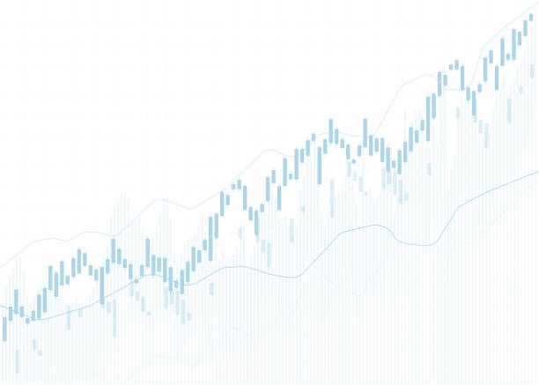
INDEX
Introduction
Primary goals
Our SOLUTION
RESULTS
THE FRONTEND
SUMMARY

Slide 3
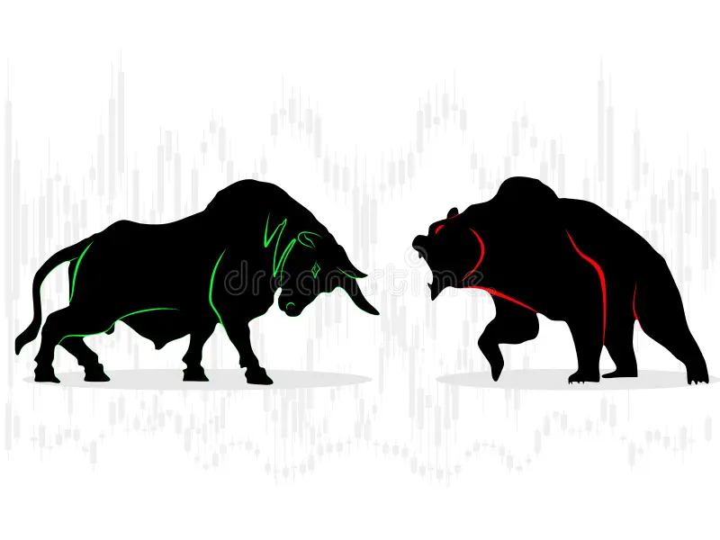
Introduction
Stock market predictions are a long-standing concern for investors. This project proposes a new model that can more accurately predict stock price movements. Stock prices are determined by investor behavior, so understanding and predicting this is important. It is expected that more accurate predictions will be possible through a different approach than existing methods. Additionally, by utilizing recently developed technologies such as machine learning and deep learning, stock market prediction accuracy will be further improved. This project is expected to contribute to the advancement of stock market forecasting technology.

Slide 4
PRIMARY GOALS
Develop a prediction model that can predict stock prices at a specific point in the future.
Stock price prediction using the latest machine learning techniques such as long-term short-term memory (LSTM).
Developing a stock market prediction model through sentiment analysis of past stock price data and news articles.
Predict stock market trends through technical and emotional analysis, develop investment strategies based on forecast results

Slide 5
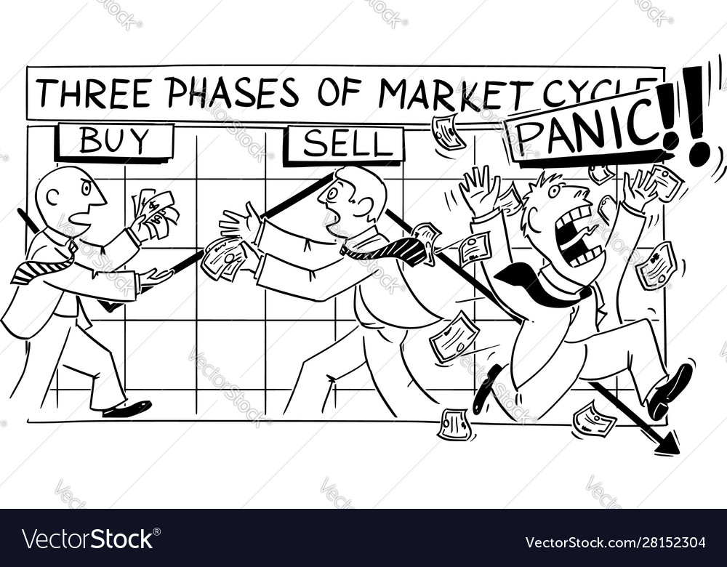
OUR SOLUTION
Data Collection and Preprocessing: Gather historical stock data, including features like opening, closing, highest, and lowest prices, along with trading volume. Preprocess the data by handling missing values, outliers, and normalizing features. Consider engineering new features like technical indicators or sentiment scores. Split the dataset into training, validation, and testing sets for model development and evaluation.

Slide 6
OUR SOLUTION
Model Building and Evaluation: Choose a suitable machine learning algorithm such as linear regression, decision trees, or neural networks. Train the model on the training data and fine-tune hyperparameters using the validation set. Evaluate the model's performance using metrics like mean squared error, root mean squared error, and coefficient of determination. Iterate on model refinement based on validation results, then test the final model on the held-out testing set to assess its generalization performance and accuracy in predicting future stock prices.

Slide 7
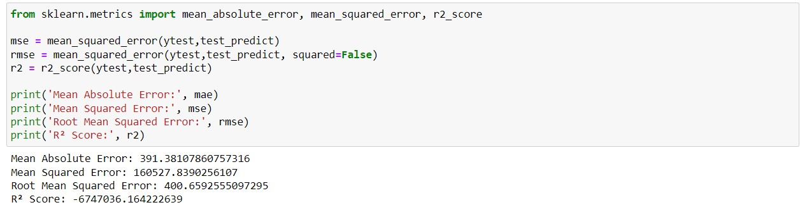
results

Slide 8
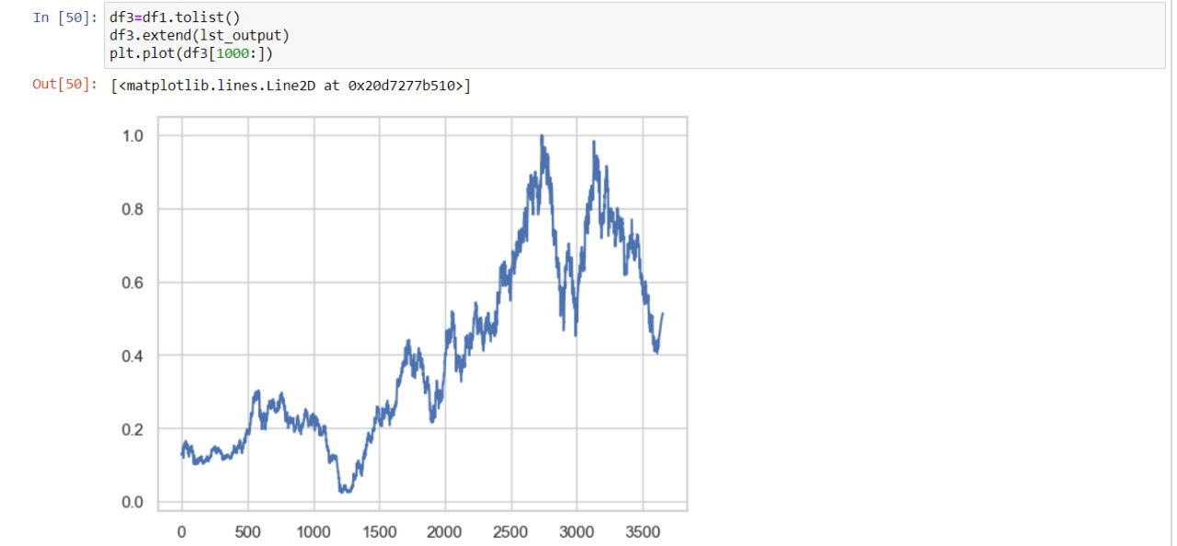
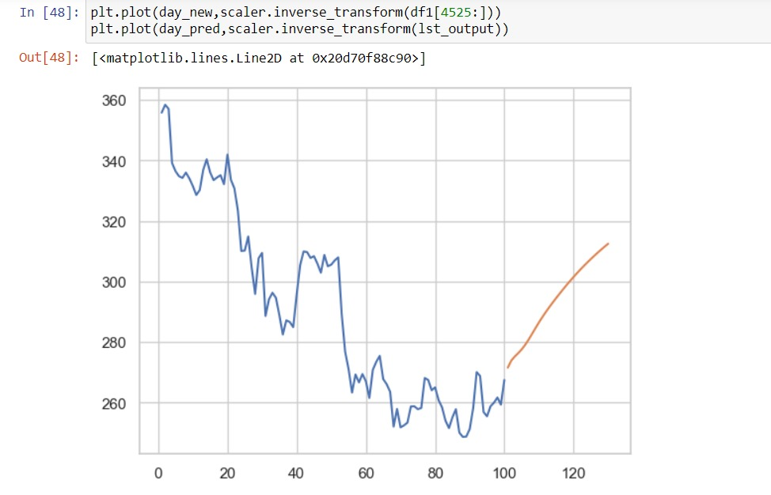
results

Slide 9
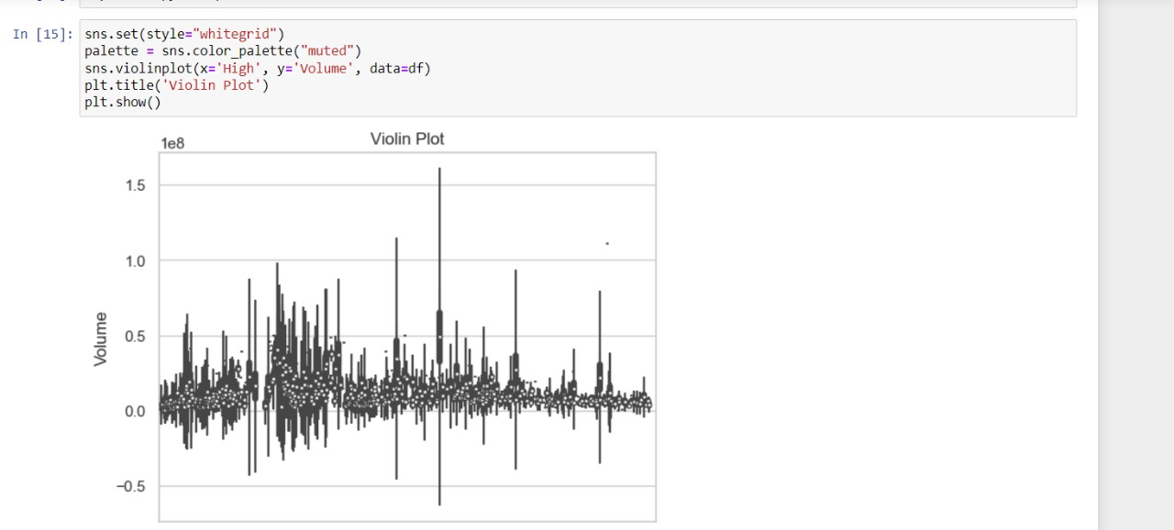

Slide 10
REFERENCES
Towards Data Science (https://towardsdatascience.com/): Towards Data Science is a popular platform for sharing machine learning and data science tutorials. You can find numerous articles and guides on stock prediction using AI and ML techniques.
Kaggle (https://www.kaggle.com/): Kaggle is a data science community that hosts competitions and provides datasets for practice. You can find various datasets related to stocks and participate in competitions focused on stock prediction.
GitHub (https://github.com/): GitHub hosts repositories containing code and projects related to machine learning and stock prediction. You can search for repositories with relevant keywords like "stock prediction" or "financial forecasting."
Medium (https://medium.com/): Medium is a platform where data scientists and machine learning practitioners often share their insights and tutorials. You can find articles and tutorials on stock prediction projects written by experts in the field.
QuantInsti (https://quantra.quantinsti.com/): QuantInsti offers courses and resources on algorithmic trading and quantitative finance. While some resources may require subscription or purchase, they provide comprehensive learning materials on stock prediction using AI and ML.
Investopedia (https://www.investopedia.com/): Investopedia is a well-known resource for financial education. They have articles and guides on various topics related to stock prediction, machine learning applications in finance, and algorithmic trading.

Slide 11
Thank YOU!

